Slide 1
Angular – Components, Directives, and Routes
Vignesh Murali Natarajan - 119780
Jason Monroe – 688776
Taryn Ernd - 785108

Slide 2
Course Objective:
At the end this session, you will be able to
Create an Angular component
Implement structural directives
Implement routing in an Angular application

Slide 3

Key topics
In this session we will be accomplishing the following goals:
Understand and Create Components
Add Bio Component to HelloAngular
Developer class
bio.component.ts
bio.component.html
Display bio in app.component.html
Discuss Component LifeCycle Hooks
Discuss and implement other bindings
Discuss and implement structural directives
Intro to Routes
Implement Routing in HelloAngular

Slide 4
Components

Slide 5
Components
Components form the building blocks of an Angular application.
A component controls a patch of the screen’s real estate, called a view, and declares reusable UI building blocks for the application.
In effect, the whole application can be modeled as a tree using these components.
Components are visible to the end user and can be reused multiple times within the application.
To create a Component, issue the following command
$ ng g component <<ComponentName>>

Slide 6
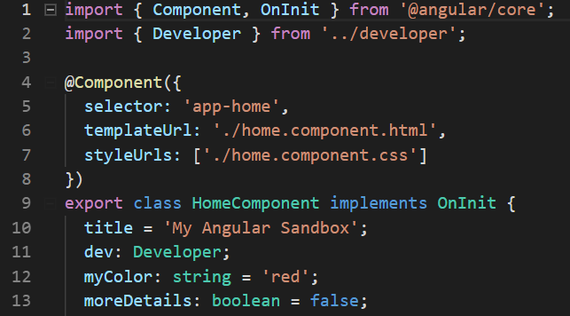
Creating Components
Decorated with the @Component
The key constituents of the decorator include -
selector: Indicates html tag name where component should be inserted.
template or templateUrl: Indicates what template or template file to insert into all occurrences of tags with the selector name.
styleUrls: indicates style sheets that will be injected into the document as script tags within this component when it is rendered

Slide 7
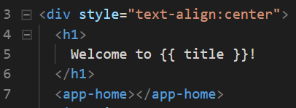
Creating Components
Display components by placing the selector in the html document.

Slide 8

Practice – HelloAngular
Make Developer Class (ng g class Developer)
firstName: string
lastName: string
favoriteLanguage: string
yearStarted: number
Make new component called ‘bio’ (ng g component bio)
Import Developer Class
Create instance of a developer inside of the constructor assign to a property called ‘dev’
Display dev component in bio.component.html
Add <app-bio></app-bio> to app.component.html
Create toggle switch using ngIF to only display bio component if link is clicked
Notes:
Instructions to Trainer:
Instructions to Facilitator:

Slide 9
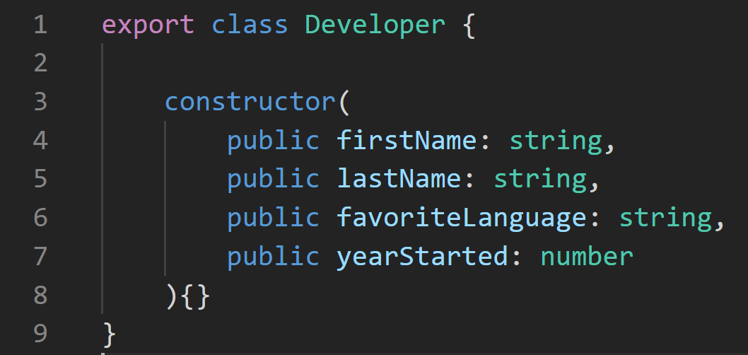
Practice – HelloAngular
Make a Developer Class
Execute ng g class Developer
Create a constructor with all of the properties as public formal parameters
Notes:
Instructions to Trainer:
Instructions to Facilitator:

Slide 10
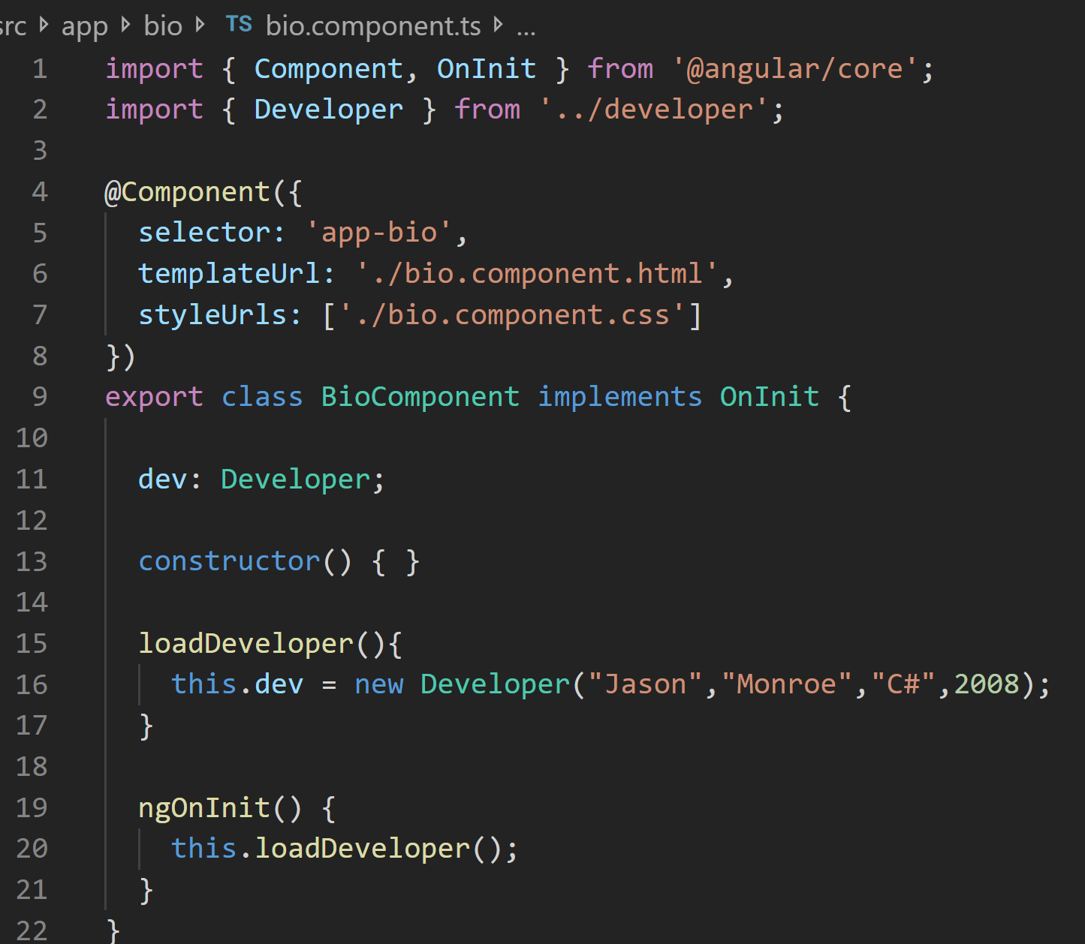
Practice – HelloAngular
Make new component called ‘bio’ (ng g component bio)
Create a dev property
Create a method called ‘loadDeveloper’ and use it to assign a new Developer instance to the dev property
Call this method from ngOnItnit()
Notes:
Instructions to Trainer:
Instructions to Facilitator:

Slide 11
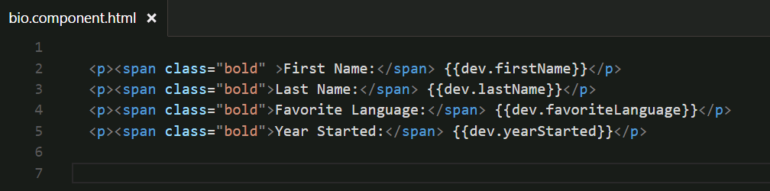
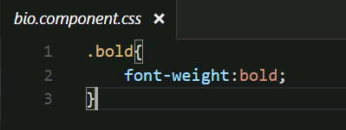
Practice – HelloAngular
Display developer attributes in bio.component.html
Add CSS rule to bio.component.css
Notes:
Instructions to Trainer:
Instructions to Facilitator:

Slide 12
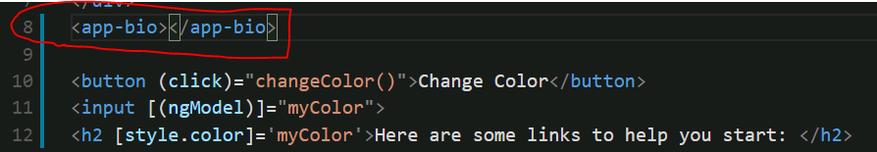
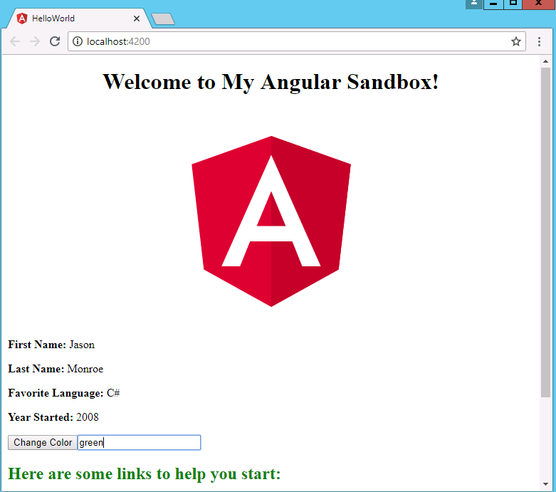
Practice – HelloAngular
Add <app-bio></app-bio> to app.component.html
Verify that your page is displaying the developer
Notes:
Instructions to Trainer:
Instructions to Facilitator:

Slide 13
Life Cycle Hooks and Structural Directives

Slide 14
Component Lifecycle
The lifecycle of a component is managed by Angular itself.
It manages creation, rendering, binding data-bound properties etc. and also offers the feature “hooks” that allows responding to key lifecycle events.
Here is the complete lifecycle hook interface inventory:
ngOnChanges - called when an input binding value changes.
ngOnInit - called after the first ngOnChanges.
ngDoCheck - called after every run of change detection.
ngAfterContentInit - called after the component content is initialized.
ngAfterContentChecked - called after every check of component content.
ngAfterViewInit - called after the component's view(s) are initialized.
ngAfterViewChecked - called after every check of a component's view(s).
ngOnDestroy - called just before the component is destroyed.

Slide 15
Other Bindings
Elvis Operator:
If a property, that does not exist, is referenced in a template, an exception is thrown.
The “Elvis Operator” is a simple and easy way to guard against null and undefined properties.
It is denoted by a question mark immediately followed by a period “?.”.
<md-input-container>
<label>Type to see the value</label>
<input md-input type="text" />
</md-input-container>
<strong>{{input?.value}}</strong>

Slide 16
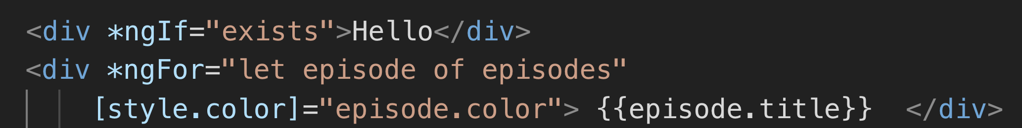
Structural Directives
Angular uses directives to transform the DOM when a template is rendered.
*ngIf adds and removes elements in the DOM based on the results of an expression.
*ngFor is a repeater directive which outputs a list of elements by iterating over an array.

Slide 17
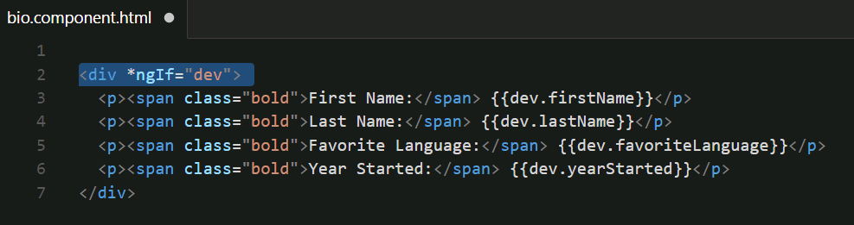
*ngIf
*ngIf will render the html tag and all nested tags if the attribute value is defined (truthy) or ‘true’ if it is a Boolean type.

Slide 18
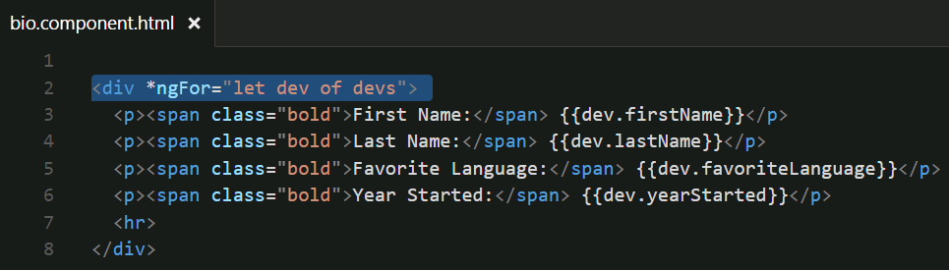
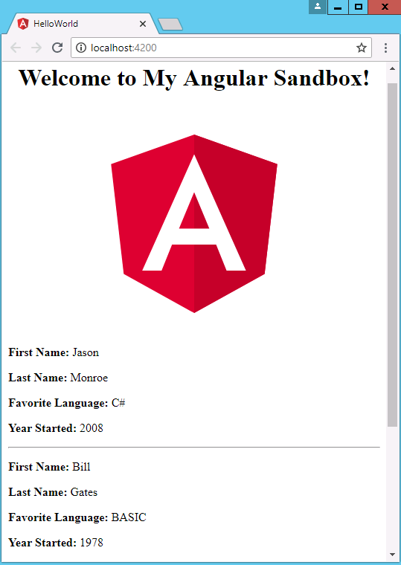
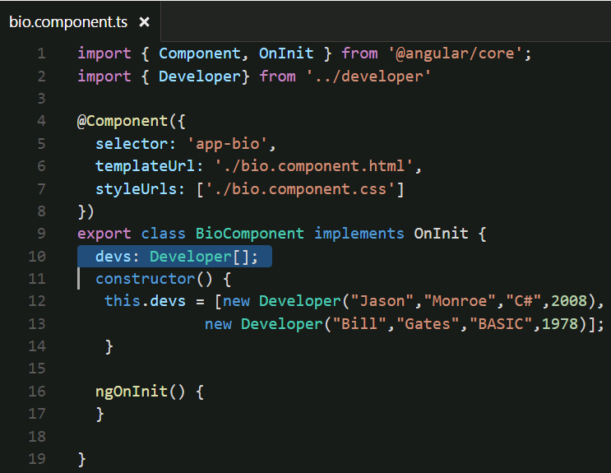
*ngFor
*ngFor will render the html tag and all nested tags for every element in an array.

Slide 19
Routing

Slide 20
Introduction to Routes
Routing allows to:
Recover browser history functionality which is otherwise lost with SPA
Maintain the state of the application.
Implement modular applications.
Implement the application based on the roles (certain roles have access to certain URLs).
Routes are injected into <router-outlet></router-outlet>. This is most commonly placed in app.component.html below any navigation bars or content that you want to appear on every page

Slide 21
App Routing Module
You can add routing after the fact
Angular best practice is to create a separate, top-level module dedicated to routing
- - flat flag will place the module in the top level
- - module=app will add the import for app-routing inside of AppModule
ng g module app-routing --flat --module=app

Slide 22
Route Configuration
Routes are configured, using the Routes type, which is an array of route objects. The route object is composed of the following attributes:
Path: URL to be shown in the browser when application is on the specific route.
Component: Component to be rendered to, when the application is on the specific route. This is the output of the router link.

Slide 23
Optional Route Attributes
redirectTo: Redirect route if needed; each route can have either component or a redirect attribute defined.
pathMatch: Optional property that defaults to 'prefix'; determines, whether to match full URLs, or just the beginning. When defining a route with empty path string set pathMatch to 'full', otherwise it will match all URLs.
children - Array of route definitions objects, representing the child routes of this route.

Slide 24
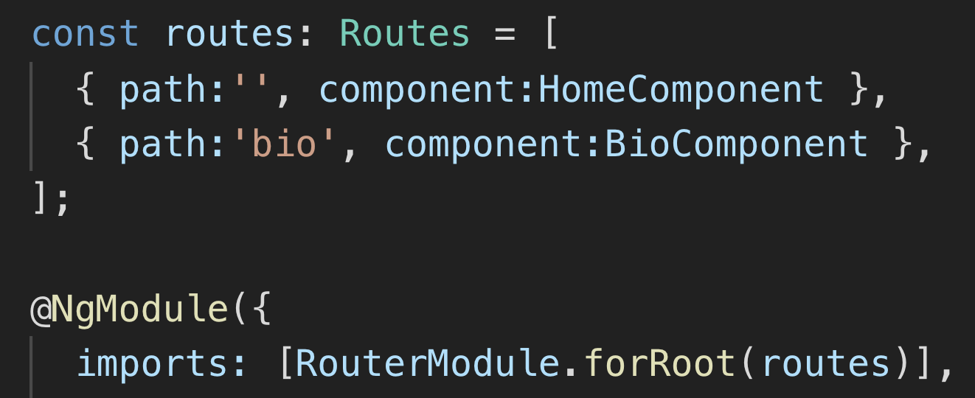
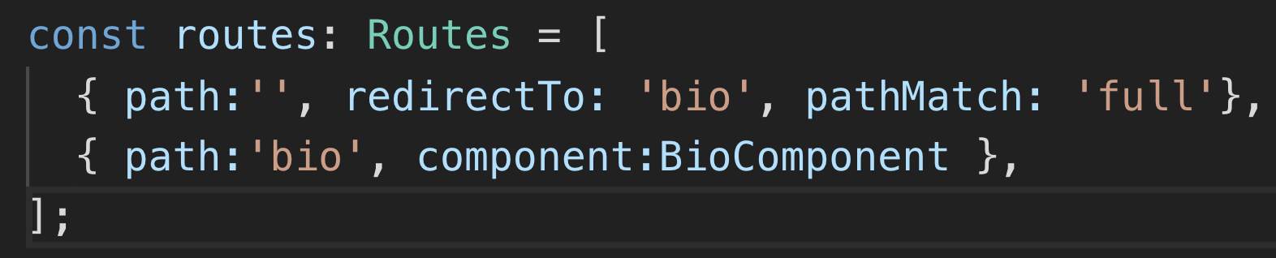
Route Configuration (Contd.)
Route array with route objects being passed to forRoot method
Angular picks the empty path, as the default landing route.
Routes may redirect to other routes, using the redirectTo attribute.

Slide 25
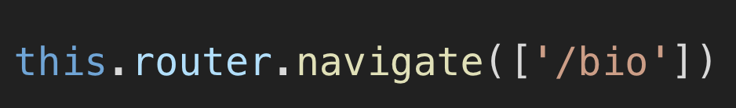
Route Navigation
In the view template, routerLink directive may be used inside of an anchor tag to add links that point to the defined routes.
To navigate programmatically, the router’s navigate method may be used.

Slide 26
Practice – HelloAngular
Create a new Component called HomeComponent
Migrate all of the content from AppComponent to HomeComponent except for the <router-outlet> tag
Set up routing in app-routing.module.ts
Add navbar to app.component.html with links to Home and DeveloperBios (bio component)
Notes:
Instructions to Trainer:
Instructions to Facilitator:

Slide 27
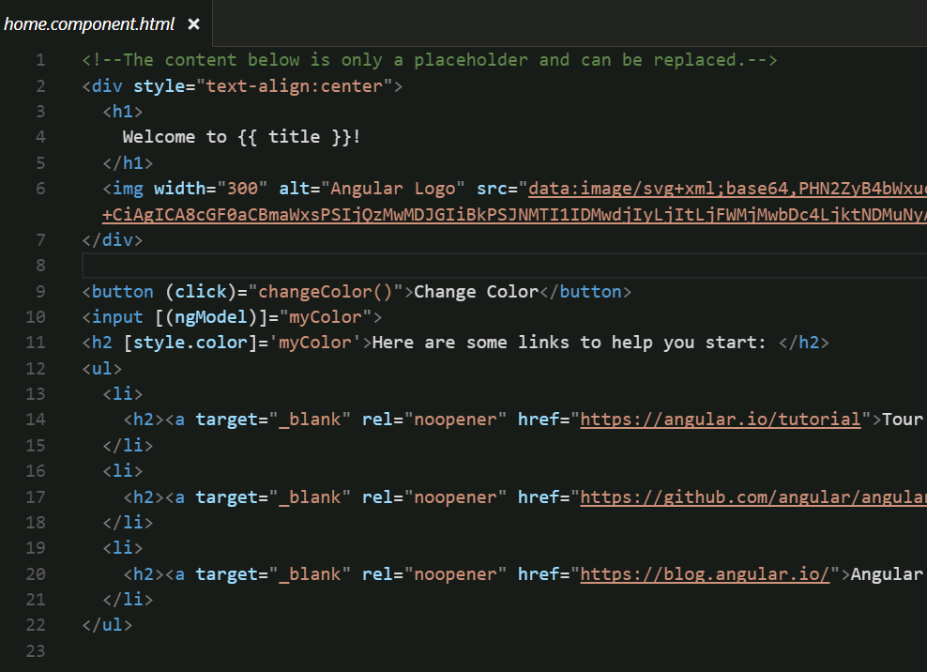
HelloAngular home.component.html
Migrate content from app.component.html here

Slide 28
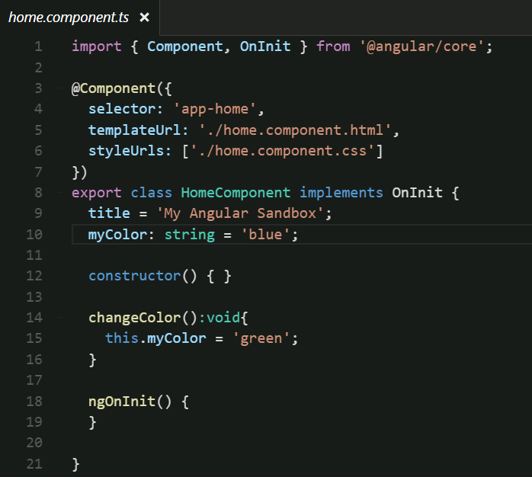
HelloAngular HomeComponent
Migrate content from AppComponent
(just the class properties and methods not the @Component stuff)

Slide 29
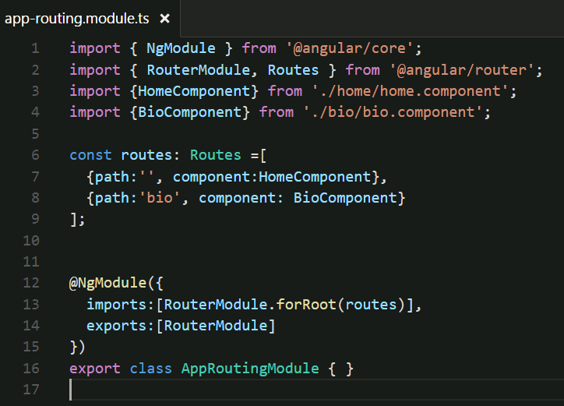
app-routing.module.ts

Slide 30
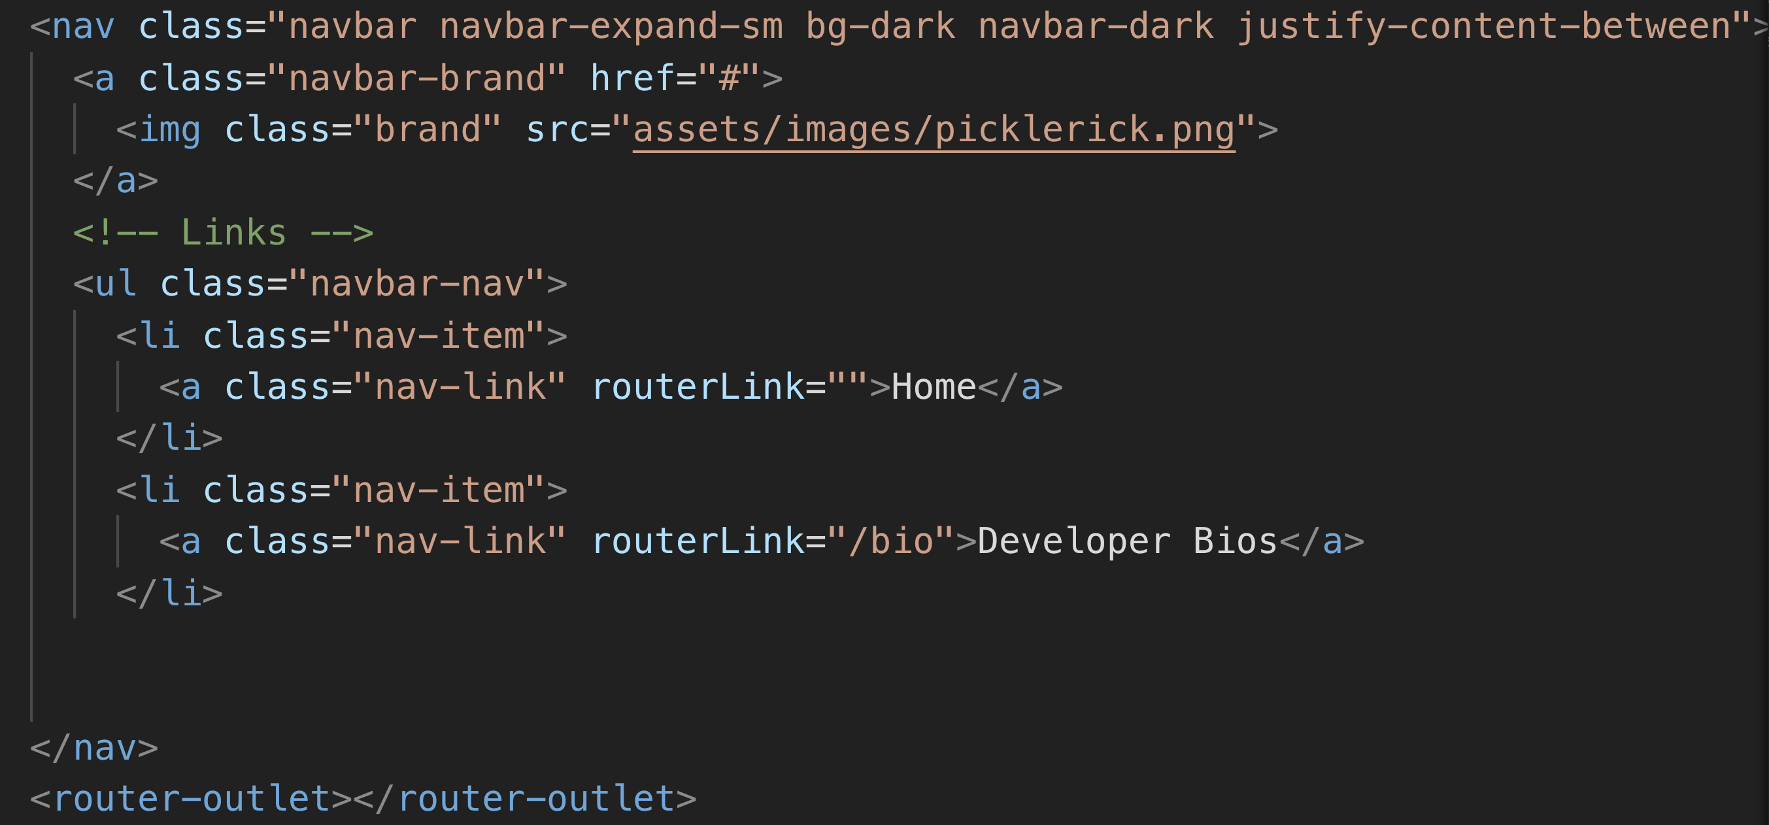
App.component.html Navbar
Add bootstrap cdn link to index.html to render Bootstrap css elements

Slide 31
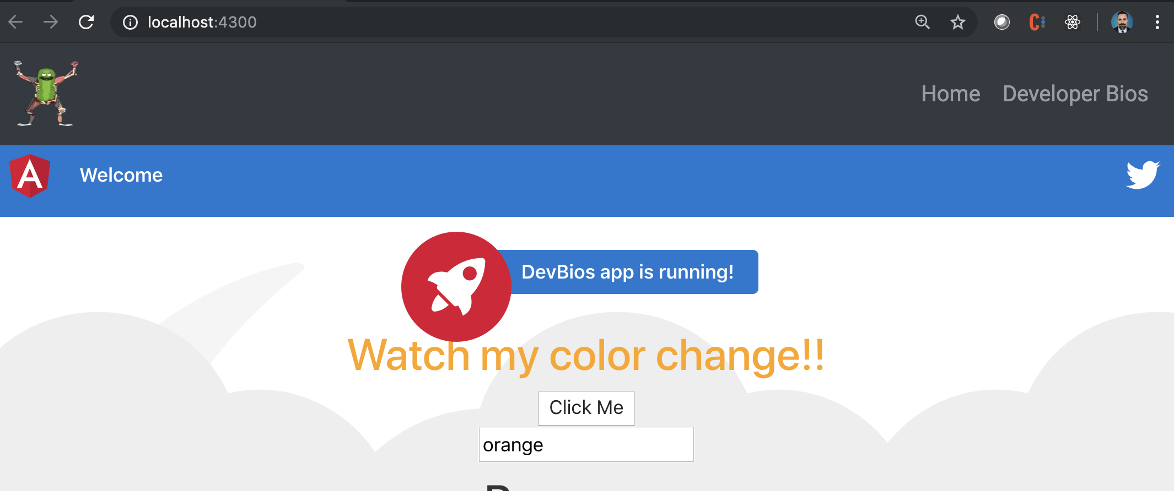
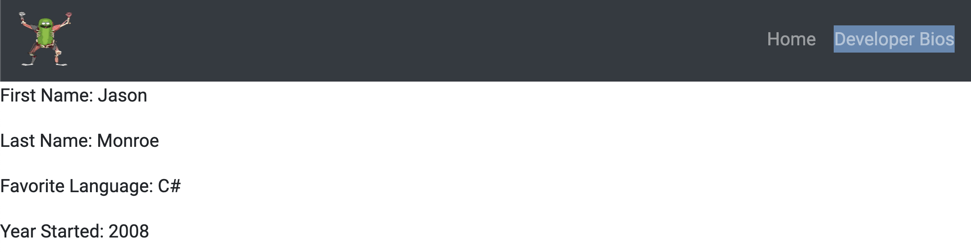
Routes in Action
Notes:
Instructions to Trainer:
Instructions to Facilitator:

Slide 32
Review
Components
ng g c <<component>>
@Component
selector
templateUrl
Style
Directives
*ngIf
*ngFor
Routes
{ path: ‘url’ component: Component }
routerLink

Slide 33
Course Objective:
At the end this session, you will be able to
Create an Angular component
Implement structural directives
Implement routing in an Angular application

Slide 34
What does it mean to say that we can preserve state in a URL?

Slide 35
Thank You

